Slide 1
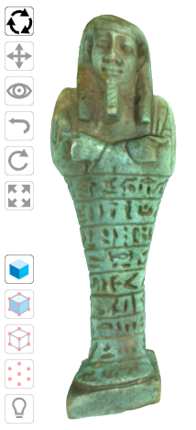
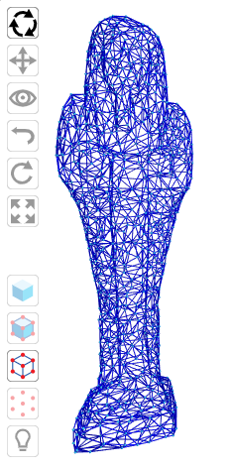
Virtual Museum ‘Takeouts’ and DIY Exhibitions – Augmented Reality Apps for Scholarship, Citizen Science and Public Engagement
Sandra Woolley
James Mitchell, Tim Collins,
Richard Rhodes, Tendai Rukasha,
Erlend Gehlken, Eugene Ch’ng and Ashley Cooke

Slide 2
Project Aim
To create technology demonstrators that could supplement the co-design of useful and easy-to-use AR apps aimed at benefiting diverse user groups that include scholars, citizen scientists and the interested public, and at providing interactive, informative and personalized views of individual artefacts and virtual reconstructions.
To enrich and supplement museum visits, support exhibition planning, and enable DIY exhibitions of collected and eclectic museum artefacts.

Slide 3
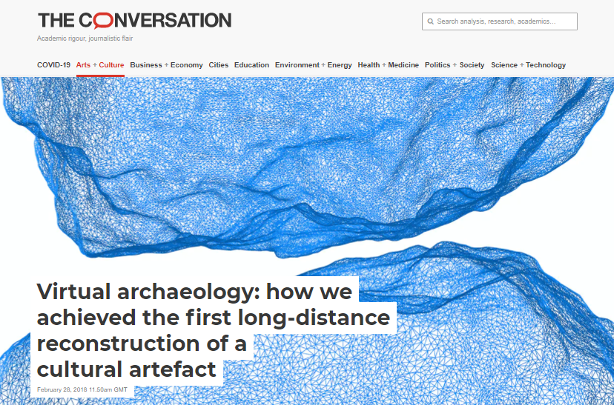
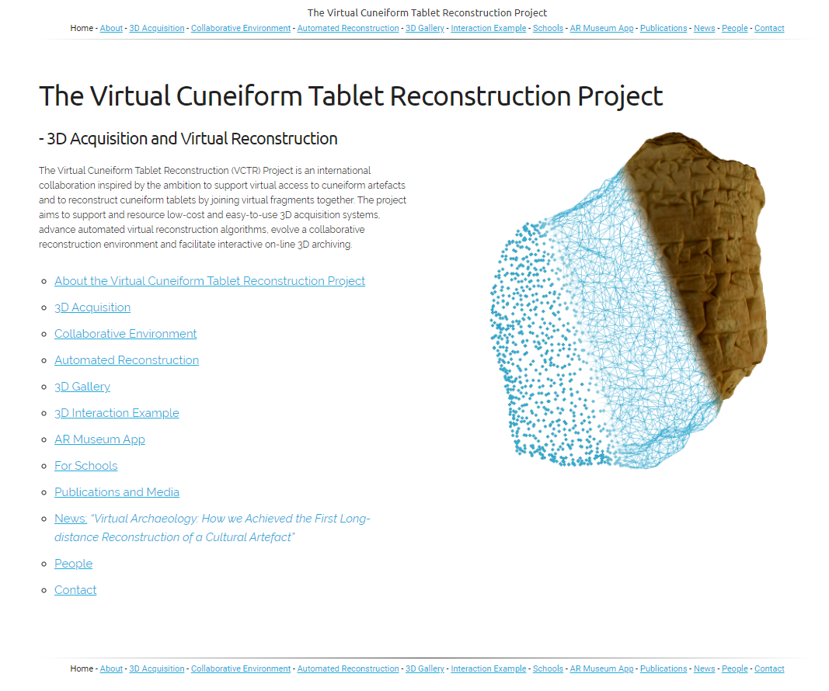
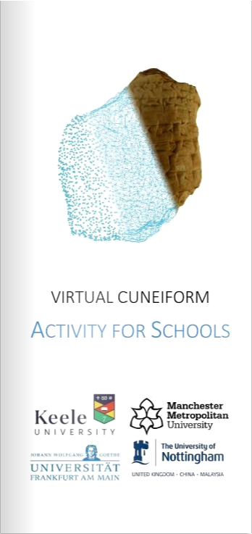
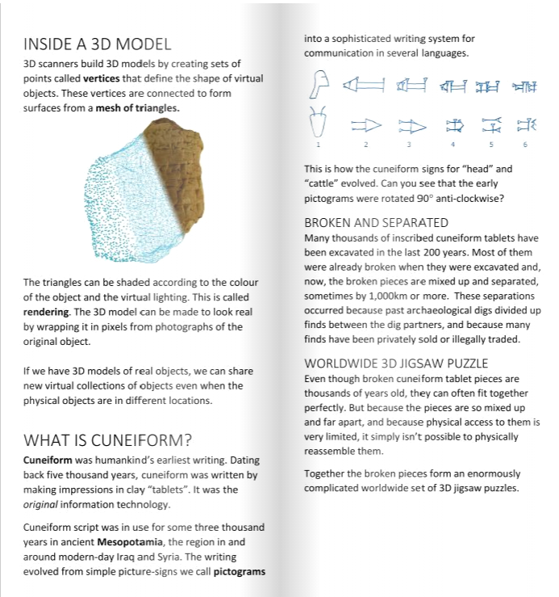
Virtual Cuneiform Tablet Reconstruction (VCTR)
The project evolved from our Virtual Cuneiform Tablet Reconstruction Project https://virtualcuneiform.org/ - a long-standing international collaboration aimed at supporting:
virtual access to cuneiform artefacts (Mesopotamian clay tablets inscribed with ancient cuneiform script)
virtual reconstruction of broken tablets.

Slide 4
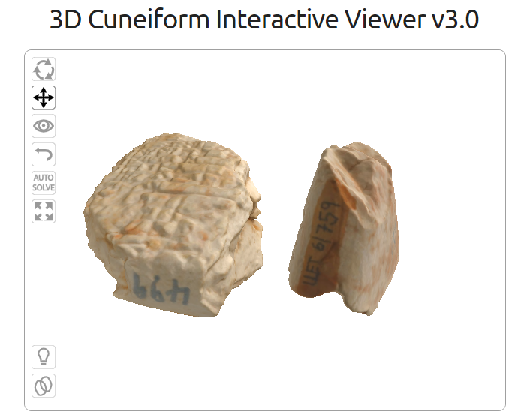
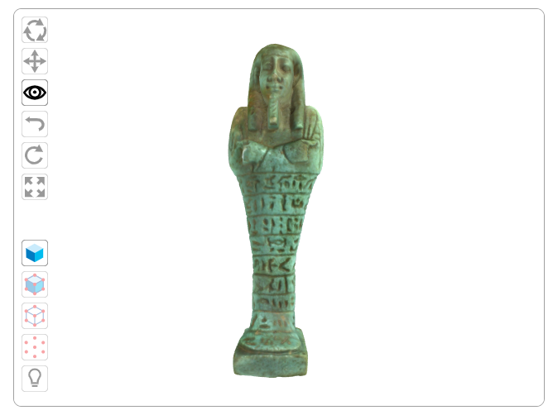
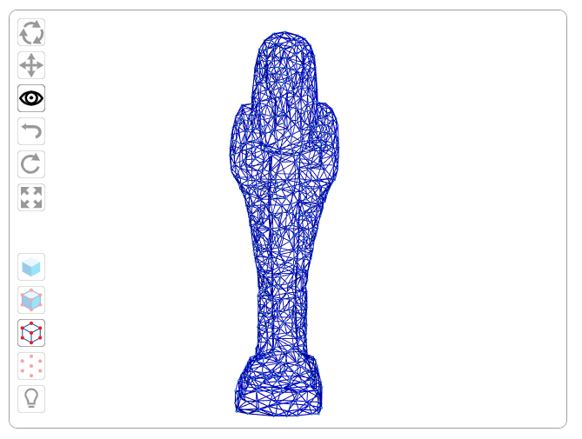
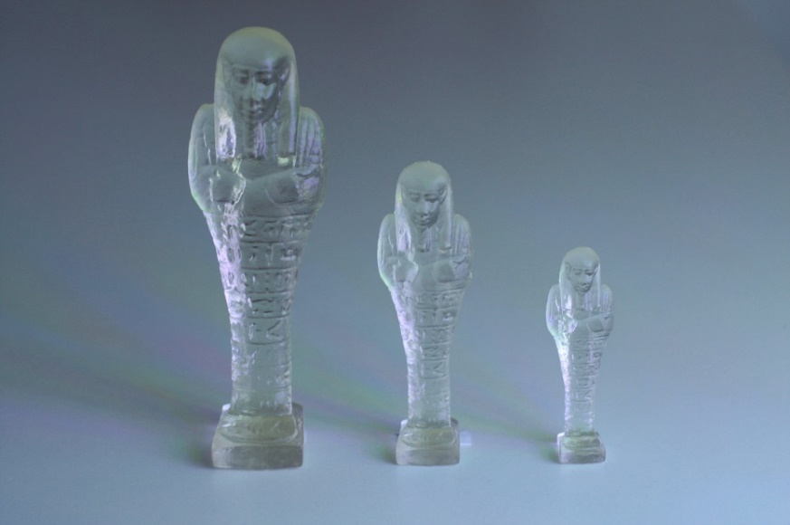
Supporting Webpages
3D prints downloadable from site

Slide 5
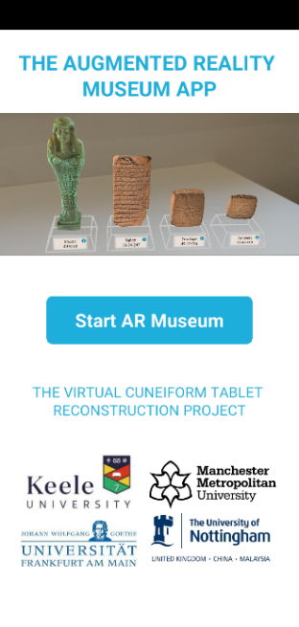
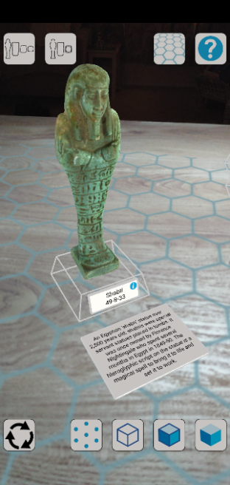
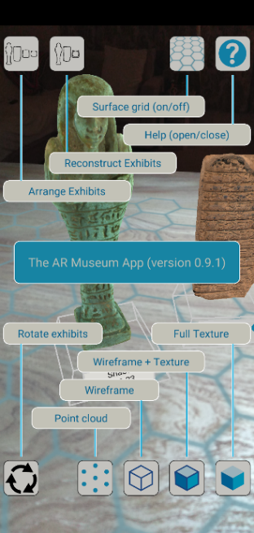
Android AR App (ARCore/Processing for Android)

Slide 6
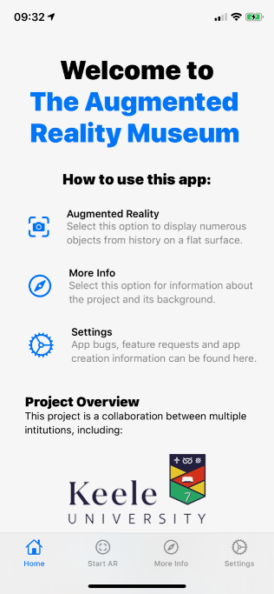
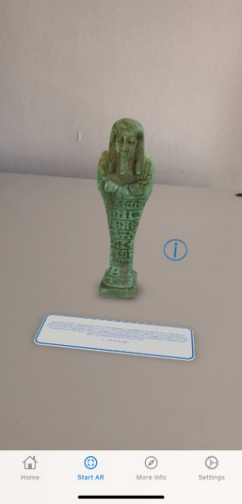
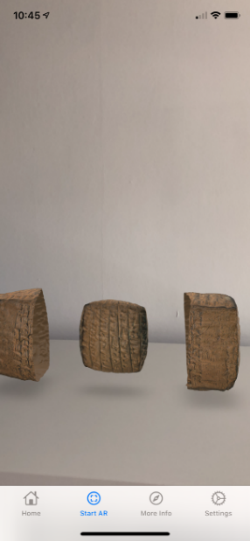
iOS AR App (Swift/Xcode/ARKit)

Slide 7
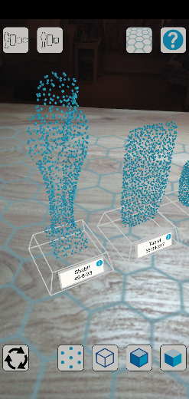
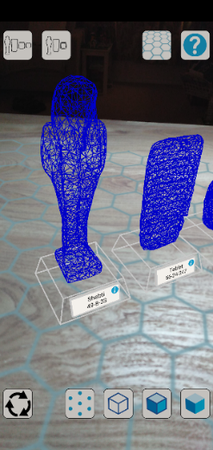
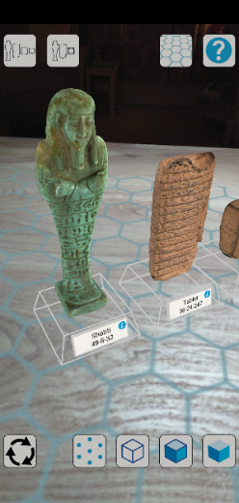
Educational 3D Model Views
point cloud view
wire mesh view
3D photographically rendered view

Slide 8
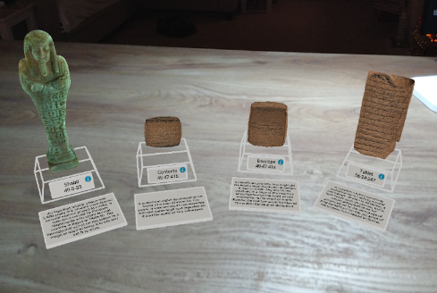
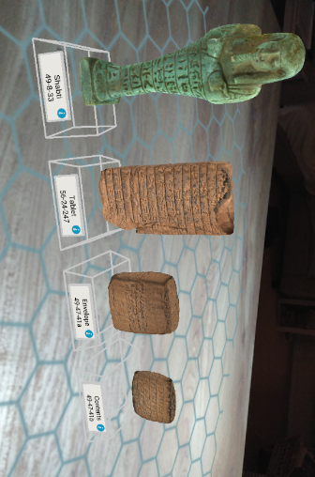
Exhibition Views and Interactions
3D exhibitions with and without surface, automated alignment and artefact information.

Slide 9
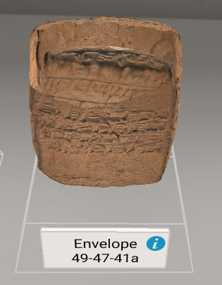
Individual and Reconstructed Artefact Views
Animated AR artefact reconstructed views of the cuneiform tablet, as it would have been, inside its envelope.

Slide 10
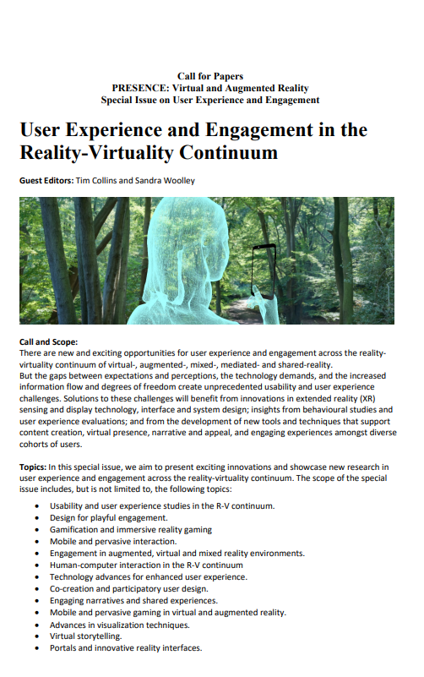
Further Work
AR app co-creation
User experience design
(Please see upcoming MIT Press PRESENCE Special Issue Call for Papers)
https://virtualcuneiform.org/
https://virtualcuneiform.org/ARMuseum.html
(see for slides with videos)
Thank you so much for listening.

